Slide 1

Dementia and Alzheimer Disease Incidence: A Prospective Cohort Study, Kukull, Walter A et al.
Reviewed by Kholoud Mohamed

Slide 2
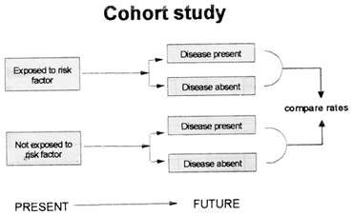
The Data

Slide 3
Introduction
Dementia and Alzheimer disease incidence: a prospective cohort study, was sourced from the Archives of Neurology/ The Journal of the American Medical Association vol. 59
Authored by: Walter A Kukull , Roger Higdon, James D Bowen, Wayne C McCormick, Linda Teri, Gerard D Schellenberg, Gerald van Belle, Lance Jolley, Eric B Larson

Slide 4
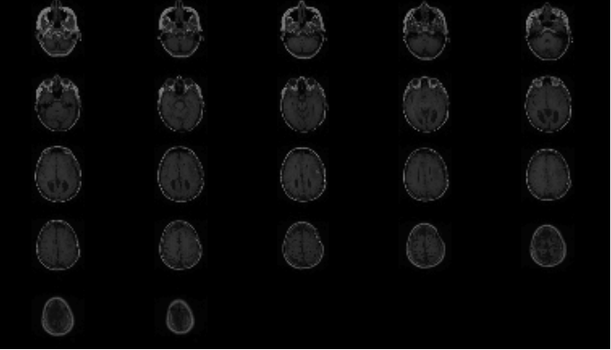
Objective of Study
Prospective Cohort study - 1994
followed unaffected individuals from the base population of seattle members of Group Health Cooperative (GHC) to observe the onset of dementia and Alzheimer disease (AD). subjects are test in followed up interviews every 2 yrs.
Obtain age-specific incidence rates estimates for Dementia and Alzheimer’s Disease using person- years approach with Poisson distribution confidence intervals.
Identify factors associated with disease onset using Cox Regression Model analysis; estimate the association of the following factors: sex,education level, race, apolopoprotein E genotype.

Slide 5
Background
Dementia: Dementia is not a specific disease but is rather a general term for the impaired ability to remember, think, or make decisions that interferes with doing everyday activities.
Alzheimer's Disease: Alzheimer’s Disease is the most common type of dementia, it is a chronic neurodegenerative disease that leads to dementia symptoms which worsen gradually over time.
Apolipoprotein E genotype: A genetic risk factor for dementia and Alzheimer's disease
Incidence: Rate of occurrence of a disease
Notes:
Incidence imp for **important for assessing risk and forming casual association with potential risk factors.

Slide 6
Experimental Methods:
Design
Base population for the study was the seattle members of Group Health Cooperative (GHC) Age 65 or older.
Cohort enrollment began in 1994 and 1996
A simple random sample of 6,782 was drawn from the base population.
Medical records were reviewed existing cases of dementia were excluded.
Subjects were administered a Cognitive Ability Screening Instrument Test (CASI) with Cut off value of 86/100. Measures cognitive decline in elderly.
CASI sensitivity = 96.5%
CASI specificity = 92%
Subjects who scored less than 80 at baseline were referred for a complete clinical diagnostic evaluation by study physicians, laboratory testing and imaging.
Subjects who scored higher than 86% on the Cognitive ability test were included in the cohort study.
Scores between 80 - 86 were considered gray area, subjects were retested within 2 month.

Slide 7
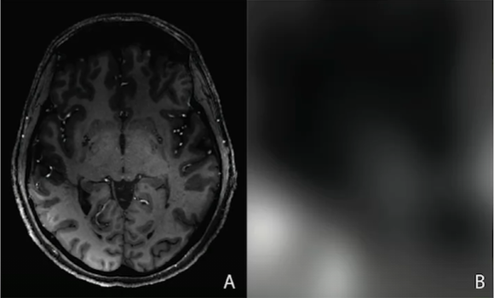
Experimental Methods:
Design
2,581 individuals were enrolled at start of study.
Blood samples were collected from consenting subjects for Apolipoprotein E genotyping.
Screened cohort members every 2 years for potential new cases
2,356 had at least one follow up examination
Subjects who did not meet the criteria for dementia/ AD were continued to be followed
Subjects who met the criteria for dementia/ AD during those follow ups were considered incidence cases.

Slide 8
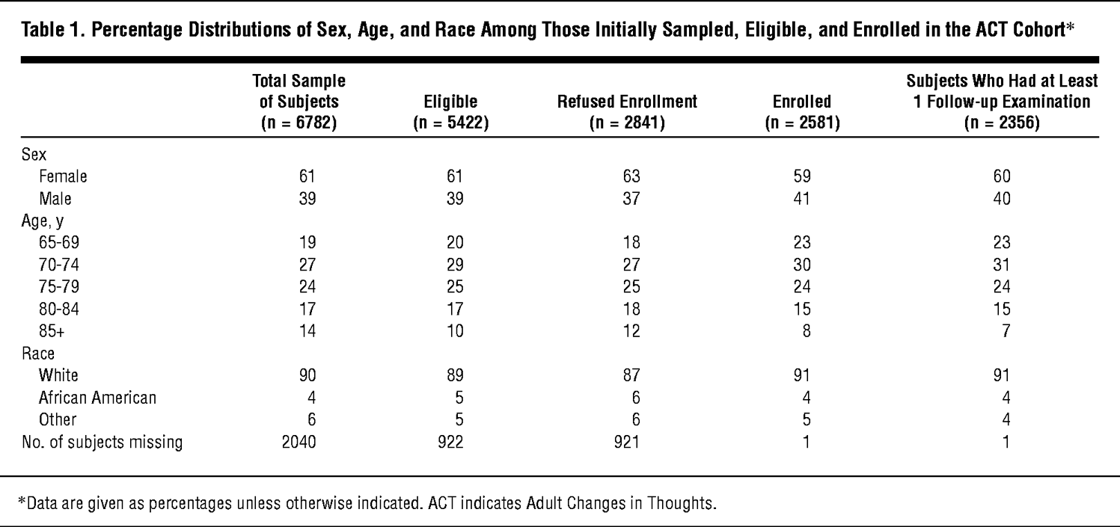
Evaluations, Graphs, and Summary Statistics
Notes:
Breakdown of how data was collected

Slide 9
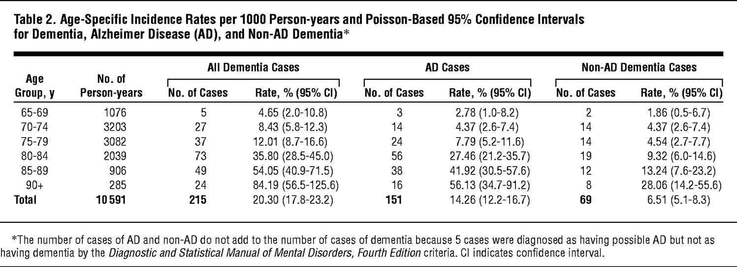
Statistical
Analysis: Part I
*Assumptions:
λ is constant over time
The probability of one event in a short interval is proportional to the interval.
Independence
Age-specific incidence rates estimates for Dementia and Alzheimer’s Disease using person- years approach with Poisson distribution confidence intervals per 1,000 person yrs

Slide 10
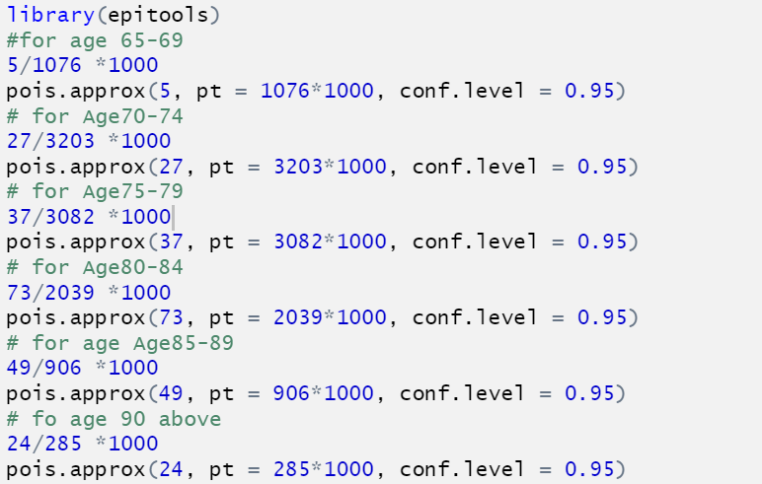
R code
for Incidence rates estimates
for each age Group

Slide 11
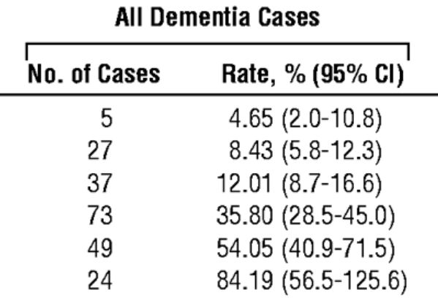
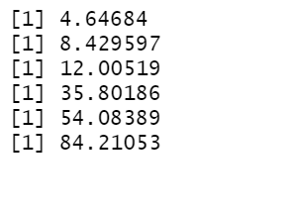
R code output
for Incidence rates estimates
for each age Group

Slide 12
Results I
Of 2,356 subjects 415 subjects screened positive for dementia. ( by CASI metric)
After clinical evaluation of 415 subjects 215 subjects were diagnosed as having dementia. And 146 diagnosed as having probable AD by Diagnostic and Statistical Manual of Mental Disorders criteria
5 subjects diagnosed as having possible AD by The National Institute of Neurological Disorders and Stroke- Alzheimer’s Disease Related Disorders Association criteria
Remaining 69 cases non-AD dementia

Slide 13
Conclusion I
Incidence rates for AD and dementia increases across age groups
Dementia rates increase from 4.65 ( 65-69) to 84.1 per 1000 person-years for (Age group, > 90)
AD rates increase from 2.8 ( 65-69) to 56.1 per 1000 person-years for(Age group, > 90)

Slide 14
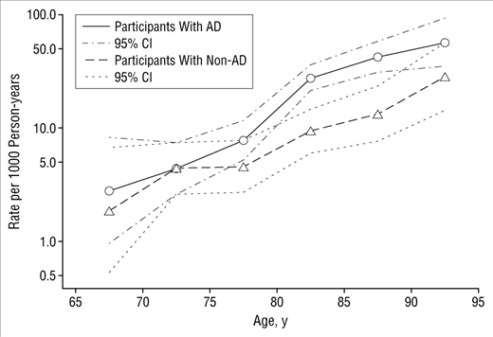
Conclusion I
The greatest number of AD cases occurred between the ages of 80 and 89 years. There is a trend of increasing age-specific incidence rates shown below.

Slide 15
Conclusion I
The rates of dementia and AD increase 3.5-fold from the (75-79) age group to the (80-84) age group.

Slide 16
Statistical Analysis Part I I : Cox Proportional Hazards Regression Model
Cox proportional hazards regression model is a regression model commonly used in medical research for investigating the association between the survival time of patients and one or more predictor variables.
Survival analysis corresponds to a set of statistical approaches used to investigate the time it takes for an event of interest to occur. ( onset of dementia)
Here Cox model allows the examination of how specific factors influence the rate of a developing dementia/AD.
Outcome is Event time which is subject to Right Censor
≥1 (event(s) happened) or 0 (no event at the end of the study, i.e. "right censored").
The hazard, denoted by h(t), is the probability that an individual who is under observation at a time t has an event at that time.

Slide 17

Statistical Analysis Part I I : Cox Proportional Hazards Regression Model
The Cox model is expressed by the hazard function h(t). The hazard function can be interpreted as the risk of dying at time t. It can be estimated as follow:
t represents the survival time
h(t) is the hazard function determined by a set of p covariates (x₁,x₂,...,x_{p})
the coefficients (b₁,b₂,...,b_{p}) measure the impact (i.e., the effect size) of covariates.
the term h₀ is called the baseline hazard. It corresponds to the value of the hazard if all the x_{i} are equal to zero (the quantity exp(0) equals 1).
The ‘t’ in h(t) reminds us that the hazard may vary over time.
The quantities exp(b_{i}) are called hazard ratios (HR)

Slide 18
Statistical Analysis Part I I : Cox proportional hazards regression model
Hazard Ratio
HR = 1: No effect
HR < 1: Reduction in the hazard
HR > 1: Increase in Hazard
Assumptions
The hazard for any individual is a fixed proportion of the hazard for any other individual. (i.e., proportional hazards)
The relationship between the log hazard and each covariate is linear,

Slide 19
Statistical Analysis Part I I : Cox Proportional Hazards Regression Model
Used to estimate the association of the following factors:
Sex
Education level (<12yrs, 12-15 yrs, <15 yrs)
Race
Apolipoprotein E genotype.
The regression model used age as time scale
Risk factors are reported as RRs ( ratios of incidence rates)

Slide 20
Statistical Analysis Part I I : Cox proportional hazards regression model Results
Sex showed no significance association with AD or Dementia
However, RR indicated that Non- AD dementia was less frequent in women than in men.
Race showed no discernible effect.
Association between Apolipoprotein E (APOE) genotype and dementia
Risk of dementia increased in subjects with single APOE ϵ4 Allele and 2 APOE ϵ4 allele.
Increased risk among homozygous subjects
Higher education level is associated with decreased risk of both AD and Non-AD dementia
There is evidence of an interaction between age and APOE ϵ4 in the incidence of dementia and AD. Subjects with a single copy of APOE ϵ4 experienced roughly a 3-fold increased risk in successive 5-year age groups (70-85 years old) but showed an RR less than 1 in the oldest age group (90+ years old).
Baseline CASI score was also strongly associated with dementia and with educational level.

Slide 21
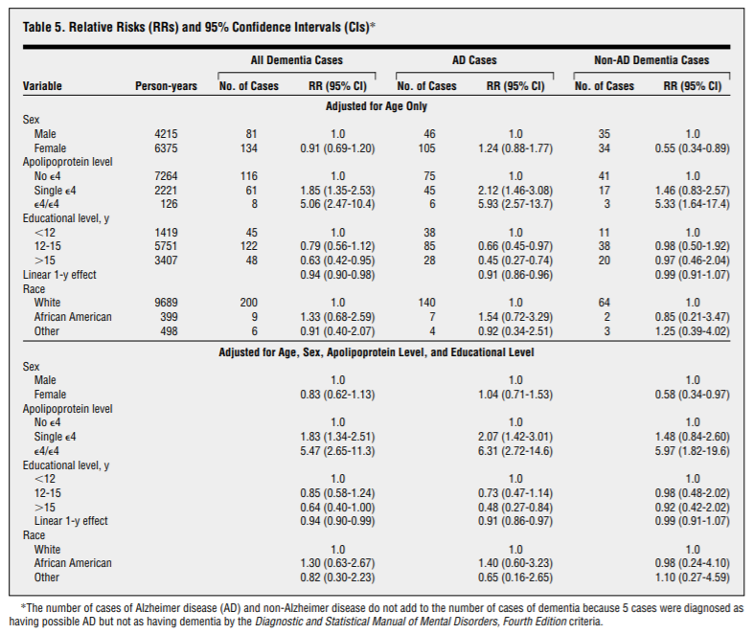
Cox proportional hazards regression model Results

Slide 22
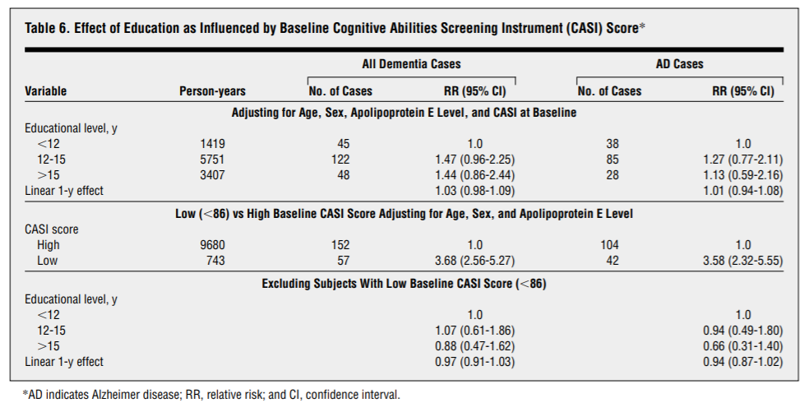

Slide 23
Part III : Multiple Imputation for handling missing data
195 failed CASI test, diagnosed as not -demented
32 failed CASI test, no definitive diagnosis - participants died
430 subjects died
180 were lost to follow up
Multiple Imputation was carried out to adjust for the 32 subjects who failed CASI test but died before receiving a definitive clinical diagnosis.
Multiple imputation fills in missing data with multiple values and runs regression analysis with the completed data set in all different entries then averages the final results for a unbiased estimate.
Used known proportion of subjects who were diagnosed as having dementia after failing CASI test as a substitute.
53% of those who failed CASI test were diagnosed as having dementia
69% were diagnosed as having probable AD

Slide 24
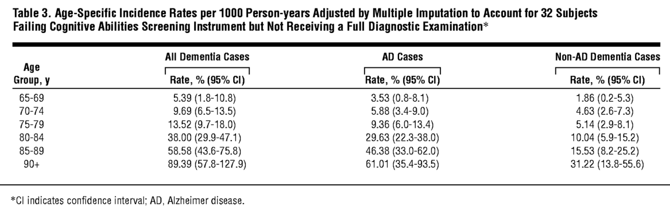
Multiple Imputation
Multiple Imputation had negligible effect on the estimation of RR or inference on risk factors.

Slide 25
Limitations with the study
Since Alzheimer’s disease and Dementia are rare, need to ensure lower false negative cases during CASI testing. Increase specificity.
Not many extensive follow up
Allow for a uniform/ standard case detection procedure and diagnostic.
CASI scores a consequence of education or a proxy for dementia?
Risk factor association could be biased due to the excessive subjects lost.

Slide 26
Appendix
Kukull, Walter A et al. “Dementia and Alzheimer disease incidence: a prospective cohort study.” Archives of neurology vol. 59,11 (2002): 1737-46. doi:10.1001/archneur.59.11.1737

